Slide 1

Chapter 8
Interval Estimation

Slide 2
Contents
Population Mean: σ Known
Population Mean: σ Unknown
Determining the Sample Size
Population Proportion

Slide 3
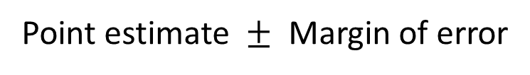
Margin of error and the Interval Estimate
A point estimator cannot be expected to provide the exact value of the population parameter.
An interval estimate can be computed by adding and subtracting a margin of error to the point estimate.
Point estimate $±$ Margin of error
The purpose of an interval estimate is to provide information about how close the point estimate, is to the value of the parameter.

Slide 4
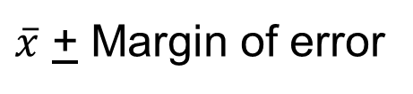
Margin of Error and the Interval Estimate
The general form of an interval estimate of a population mean is
$\overline{x}$ + Margin of error

Slide 5
Interval Estimate of a Population Mean: σ Known
In order to develop an interval estimate of a population mean, the margin of error must be computed using either:
the population standard deviation σ , or
the sample standard deviation s
σ is rarely known exactly. But often a good estimate can be obtained based on historical data or other information.
We refer to such cases as the σ known case.

Slide 6
Interval Estimate of a Population Mean: σ Known
Example: Lloyds Department Store
Each week Lloyds department store selects a simple random sample of 100 customers in order to learn about the amount spent per shopping trip. The historical data indicates that the population follows a normal distribution.
During most recent week, Lloyd’s surveyed 100 customers (n = 100) and obtained a sample mean of (𝑥 ) ̅ = $82. Based on historical data, Lloyd’s now assumes a known value of 𝜎 = $20. The confidence coefficient to be used in the interval estimate is .95.

Slide 7
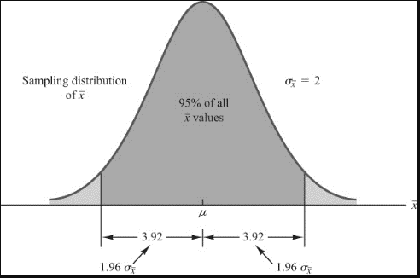
Interval Estimate of a Population Mean: σ Known
Using the standard normal probability table, we know that 95% of the values of any normally distributed random variable are within ±1.96 standard deviations of the mean.

Slide 8
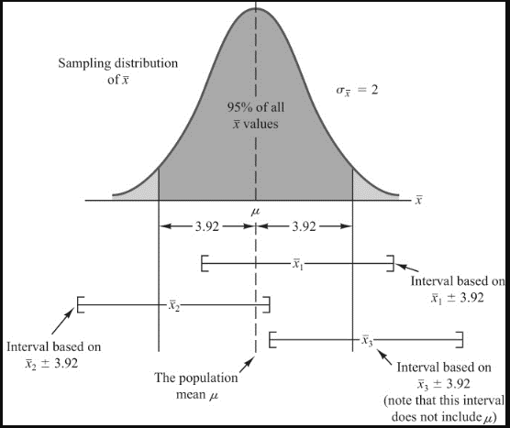
Interval Estimate of a Population Mean: σ Known
Example: Lloyds Department
store
Interval estimate of μ is:
$82 + $ 3.92
or
$78.08 to $85.29
We are 95% confident that the interval contains the population mean.

Slide 9
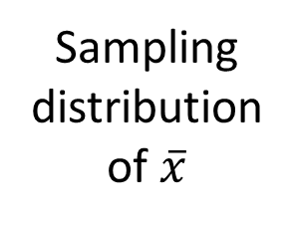
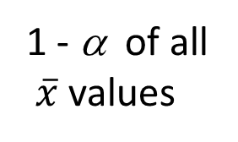
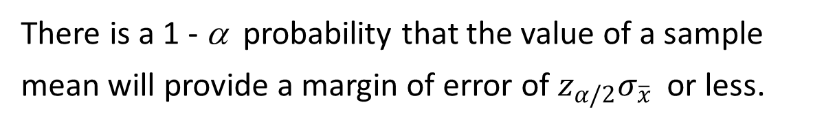
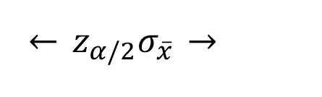
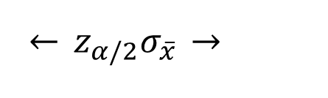

Interval Estimate of a Population Mean: σ Known
There is a 1 - α probability that the value of a sample
mean will provide a margin of error of $z_{α/2}σ_{\overline{x}}$ or less.
Sampling
distribution
of $\overline{x}$
1 - α of all
$\overline{x}$ values
α/2
α/2
$$\overline{x}$$
μ
$$\overset{←}{} z_{α/2}σ_{\overline{x}} \overset{→}{}$$
$$\overset{←}{} z_{α/2}σ_{\overline{x}} \overset{→}{}$$

Slide 10
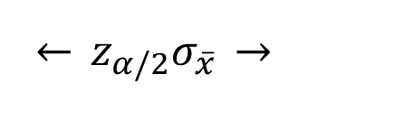


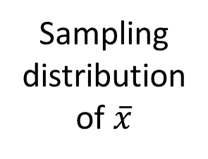

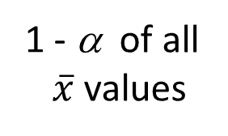
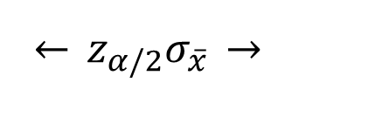
Interval Estimate of a Population Mean: σ Known
Sampling
distribution
of $\overline{x}$
1 - α of all
$\overline{x}$ values
α/2
α/2
$$\overline{x}$$
μ
$$\overset{←}{} z_{α/2}σ_{\overline{x}} \overset{→}{}$$
$$\overset{←}{} z_{α/2}σ_{\overline{x}} \overset{→}{}$$
interval
does not
include μ
interval
includes μ
$$\left[−−−−−\overline{x}−−−−−\right]$$
$$\left[−−−−−\overline{x}−−−−−\right]$$

Slide 11
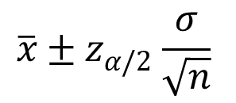
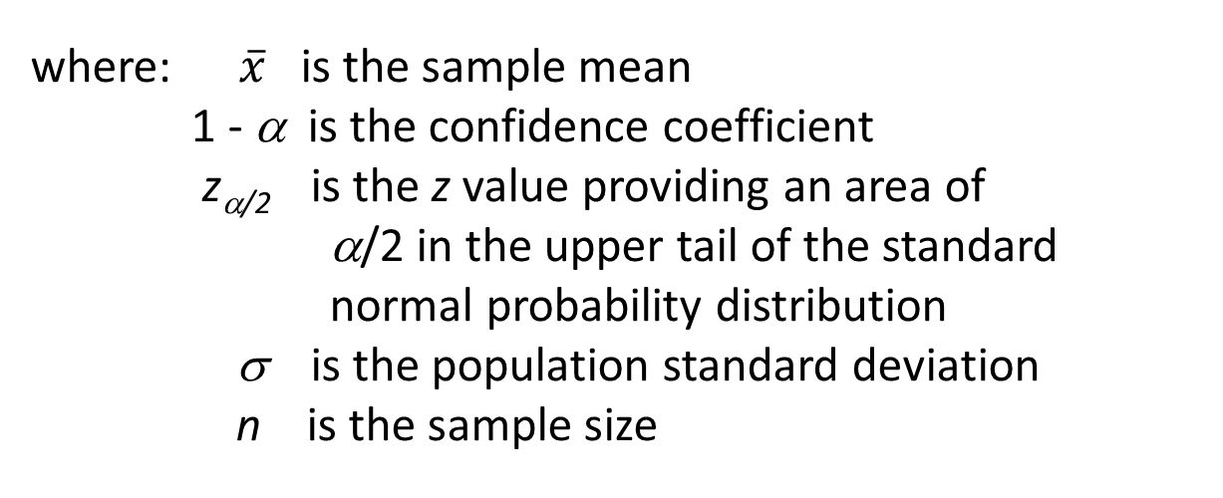
Interval Estimate of a Population Mean: σ Known
Interval Estimate of μ
$$\overline{x}{± z}_{α/2}\frac{σ}{\sqrt{n}}$$
where: $\overline{x}$ is the sample mean
1 - α is the confidence coefficient
z_{α/2} is the z value providing an area of
α/2 in the upper tail of the standard
normal probability distribution
σ is the population standard deviation
n is the sample size

Slide 12
Interval Estimate of a Population Mean: σ Known
Values of z_{α/2} for the Most Commonly Used Confidence Levels
Confidence Table
Level α α/2 Look-up Area z_{α/2}
90% .10 .05 .9500 1.645
95% .05 .025 .9750 1.960
99% .01 .005 .9950 2.576

Slide 13
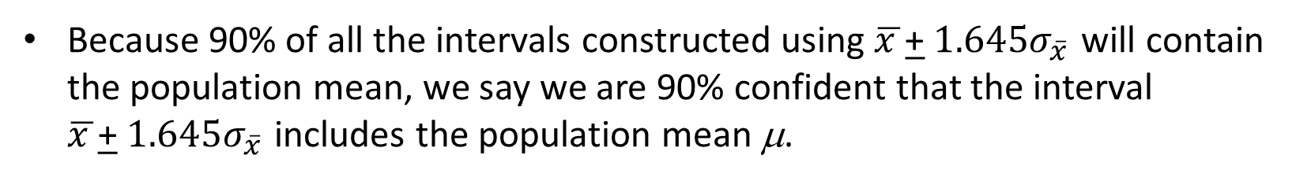
Meaning of Confidence
Because 90% of all the intervals constructed using $\overline{x }$+ $1.645σ_{\overline{x} }$will contain the population mean, we say we are 90% confident that the interval $\overline{x }$+ $1.645σ_{\overline{x} }$includes the population mean μ.
We say that this interval has been established at the 90% confidence level.
The value .90 is referred to as the confidence coefficient.

Slide 14
Interval Estimate of a Population Mean: σ Known
Example: Discount Sounds
Discount Sounds has 260 retail outlets throughout the United States. The firm is evaluating a potential location for a new outlet, based in part, on the mean annual income of the individuals in the marketing area of the new location.
A sample of size n = 36 was taken; the sample mean income is $41,100. The population is not believed to be highly skewed. The population standard deviation is estimated to be $4,500, and the confidence coefficient to be used in the interval estimate is .95.

Slide 15
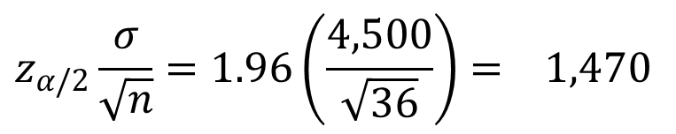
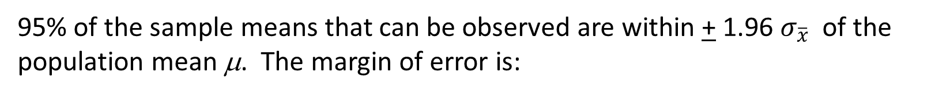
Interval Estimate of a Population Mean: σ Known
Example: Discount Sounds
95% of the sample means that can be observed are within + 1.96 $σ_{\overline{x}}$ of the population mean μ. The margin of error is:
$$z_{α/2}\frac{σ}{\sqrt{n}}=1.96\left(\frac{4,500}{\sqrt{36}}\right)= 1,470$$
Thus at 95% confidence, the margin of error is $1,470.

Slide 16
Interval Estimate of a Population Mean: σ Known
Example: Discount Sounds
Interval estimate of μ is:
$41,100 + $1,470
or
$39,630 to $42,570
We are 95% confident that the interval contains the population mean.

Slide 17
Interval Estimate of a Population Mean: σ Known
Example: Discount Sounds
Confidence Margin
level of error Interval estimate
90% 1,234 39,866 to 42,334
95% 1,470 39,630 to 42,570
99% 1,932 39,168 to 43,032
In order to have a higher degree of confidence, the margin of error and thus the width of the confidence interval must be larger.

Slide 18
Interval Estimate of a Population Mean: σ Known
Adequate Sample Size
In most applications, a sample size of n$≥$ 30 is adequate.
If the population distribution is highly skewed or contains outliers, a sample size of 50 or more is recommended.
If the population is not normally distributed but is roughly symmetric, a sample size as small as 15 will suffice.
If the population is believed to be at least approximately normal, a sample size of less than 15 can be used.

Slide 19
Interval Estimate of a Population Mean: σ Unknown
If an estimate of the population standard deviation σ cannot be developed prior to sampling, we use the sample standard deviation s to estimate σ .
This is the σ unknown case.
In this case, the interval estimate for μ is based on the t distribution.
(We’ll assume for now that the population is normally distributed.)

Slide 20
t Distribution
William Gosset, writing under the name “Student”, is the founder of the t distribution.
Gosset was an Oxford graduate in mathematics and worked for the Guinness Brewery in Dublin.
He developed the t distribution while working on small-scale materials and temperature experiments.

Slide 21
t Distribution
The t distribution is a family of similar probability distributions.
A specific t distribution depends on a parameter known as the degrees of freedom.
Degrees of freedom refer to the number of independent pieces of information that go into the computation of s.
A t distribution with more degrees of freedom has less dispersion.
As the degrees of freedom increases, the difference between the t distribution and the standard normal probability distribution becomes smaller and smaller.

Slide 22
t Distribution
Standard
normal
distribution
t distribution
(20 degrees
of freedom)
t distribution
(10 degrees
of freedom)
z, t
0

Slide 23
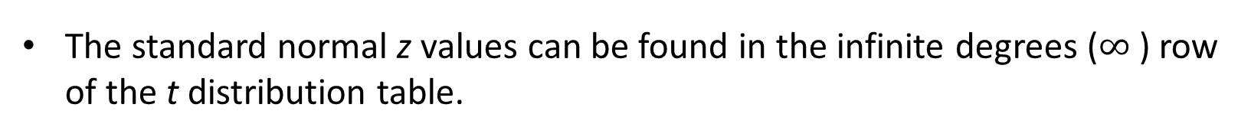
t Distribution
For more than 100 degrees of freedom, the standard normal z value provides a good approximation to the t value.
The standard normal z values can be found in the infinite degrees ($∞$ ) row of the t distribution table.

Slide 24
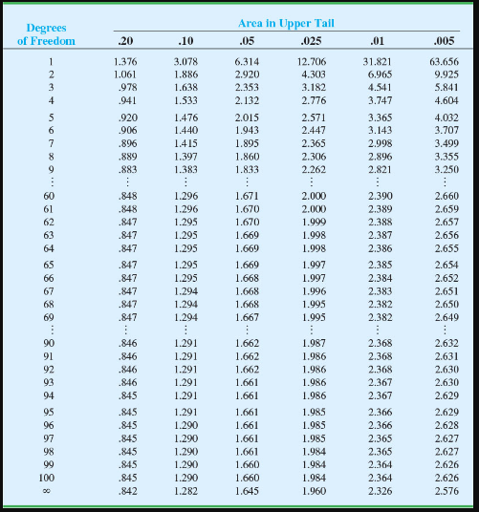
t Distribution
(bottom row is standard normal z values)

Slide 25

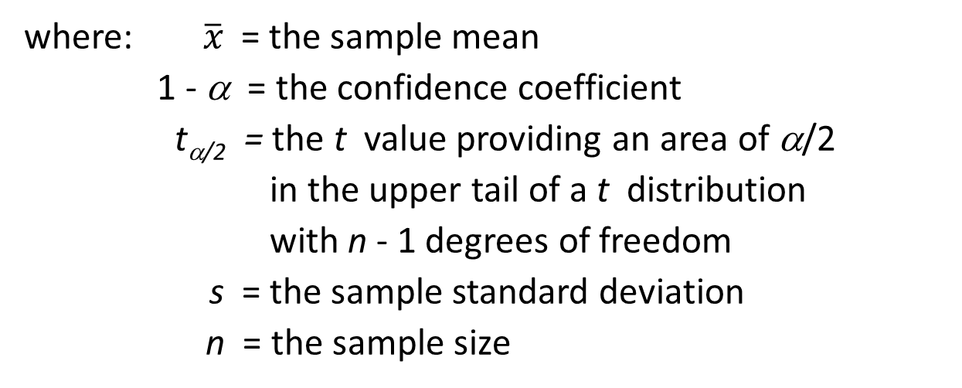
Interval Estimate of a Population Mean: σ Unknown
Interval Estimate
$$\overline{x}{ ± t}_{α/2}\frac{s}{\sqrt{n}}$$
where: $\overline{x}$ = the sample mean
1 - α = the confidence coefficient
t_{α/2} = the t value providing an area of α/2
in the upper tail of a t distribution
with n - 1 degrees of freedom
s = the sample standard deviation
n = the sample size

Slide 26
Interval Estimate of a Population Mean: σ Unknown
Example: Apartment Rents
A reporter for a student newspaper is writing an article on the cost of off-campus housing. A sample of 16 one-bedroom apartments within a half-mile of campus resulted in a sample mean of $750 per month and a sample standard deviation of $55.
Let us provide a 95% confidence interval estimate of the mean rent per month for the population of one-bedroom apartments within a half-mile of campus. We will assume this population to be normally distributed.

Slide 27
Interval Estimate of a Population Mean: σ Unknown
At 95% confidence, α = .05, and α/2 = .025.
t_{.025} is based on n - 1 = 16 - 1 = 15 degrees of freedom.
Degrees
Area in Upper Tail
of Freedom
.20
.10
.05
.025
.01
.005
15
.866
1.341
1.753
2.131
2.602
2.947
16
.865
1.337
1.746
2.120
2.583
2.921
17
.863
1.333
1.740
2.110
2.567
2.898
18
.862
1.330
1.734
2.101
2.520
2.878
19
.861
1.328
1.729
2.093
2.539
2.861
.
.
.
.
.
.
.

Slide 28
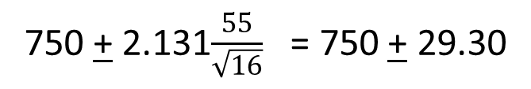
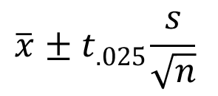
Interval Estimate of a Population Mean: σ Unknown
Interval Estimate
$$\overline{x}{ ± t}_{.025}\frac{s}{\sqrt{n}}$$
750 + 2.131$\frac{55}{\sqrt{16}}$ = 750 + 29.30
We are 95% confident that the mean rent per month
for the population of one-bedroom apartments within
a half-mile of campus is between $720.70 and $779.30.

Slide 29
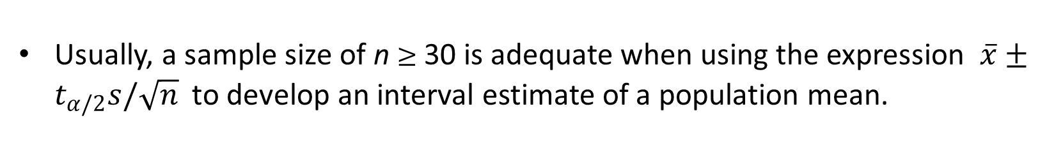
Interval Estimate of a Population Mean: σ Unknown
Adequate Sample Size
Usually, a sample size of n $≥$ 30 is adequate when using the expression $\overline{x}±t_{α/2}s/\sqrt{n}$ to develop an interval estimate of a population mean.
If the population distribution is highly skewed or contains outliers, a sample size of 50 or more is recommended.
If the population is not normally distributed but is roughly symmetric, a sample size as small as 15 will suffice.
If the population is believed to be at least approximately normal, a sample size of less than 15 can be used.

Slide 30


Summary of Interval Estimation Procedures
for a Population Mean
Can the
population standard
deviation σ be assumed
known ?
Yes
No
Use the sample
standard deviation
s to estimate σ
Use
Use
$$\overline{x}{± z}_{α/2}\frac{σ}{\sqrt{n}}$$
σ Known
Case
σ Unknown
Case
$$\overline{x}{ ± t}_{α/2}\frac{s}{\sqrt{n}}$$

Slide 31
Sample Size for an Interval Estimate of a Population Mean
Let E = the desired margin of error.
E is the amount added to and subtracted from the point estimate to obtain an interval estimate.
If a desired margin of error is selected prior to sampling, the sample size necessary to satisfy the margin of error can be determined.

Slide 32
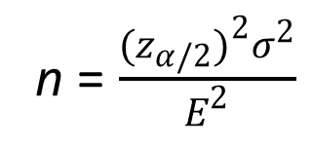
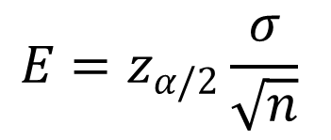
Sample Size for an Interval Estimate of a Population Mean
Margin of error
$$E=z_{α/2}\frac{σ}{\sqrt{n}}$$
Necessary Sample Size
n = $\frac{(z_{α/2})^{2}σ^{2}}{E^{2}}$

Slide 33
Sample Size for an Interval Estimate of a Population Mean
The Necessary Sample Size equation requires a value for the population standard deviation σ .
If σ is unknown, a preliminary or planning value for σ can be used in the equation.
1. Use the estimate of the population standard deviation computed in a previous study.
2. Use a pilot study to select a preliminary sample and use the sample standard deviation from the study.
3. Use judgment or a “best guess” for the value of σ.

Slide 34
Sample Size for an Interval Estimate of a Population Mean
Example: Discount Sounds
Recall that Discount Sounds is evaluating a potential location for a new retail outlet, based in part, on the mean annual income of the individuals in the marketing area of the new location.
Suppose that Discount Sounds’ management team wants an estimate of the population mean such that there is a .95 probability that the sampling error is $500 or less.
How large a sample size is needed to meet the required precision?

Slide 35
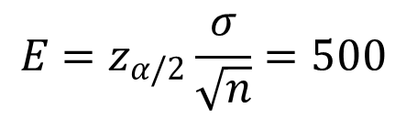
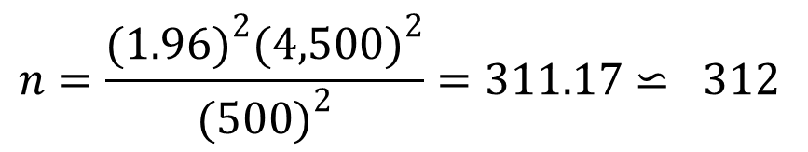
Sample Size for an Interval Estimate of a Population Mean
$${E=z}_{α/2}\frac{σ}{\sqrt{n}}=500$$
At 95% confidence, z_{.025} = 1.96. Recall that σ = 4,500.
$$n=\frac{(1.96)^{2}(4,500)^{2}}{(500)^{2}}=311.17⋍ 312$$
A sample of size 312 is needed to reach a desired precision of + $500 at 95% confidence.

Slide 36
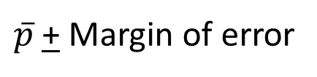
Interval Estimate of a Population Proportion
The general form of an interval estimate of a population proportion is:
$\overline{p}$ + Margin of error

Slide 37
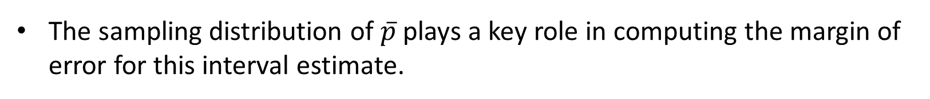
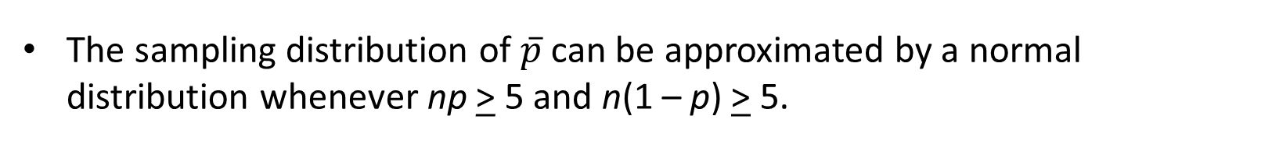
Interval Estimate of a Population Proportion
The sampling distribution of $\overline{p}$ plays a key role in computing the margin of error for this interval estimate.
The sampling distribution of $\overline{p}$ can be approximated by a normal distribution whenever np > 5 and n(1 – p) > 5.

Slide 38



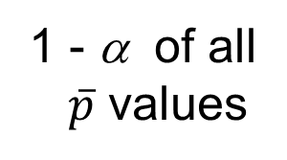

Interval Estimate of a Population Proportion
Normal Approximation of Sampling Distribution of $\overline{p}$
$$σ_{\overline{p}}=\sqrt{\frac{p(1−p)}{n}}$$
α /2
1 - α of all
$\overline{p}$ values
α /2
$$\overline{p}$$
p
$$←z_{α/2}σ_{\overline{p}}→$$
$$←z_{α/2}σ_{\overline{p}}→$$

Slide 39
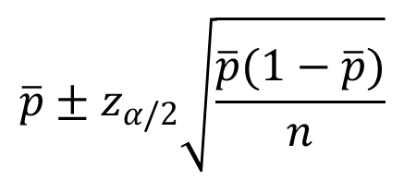
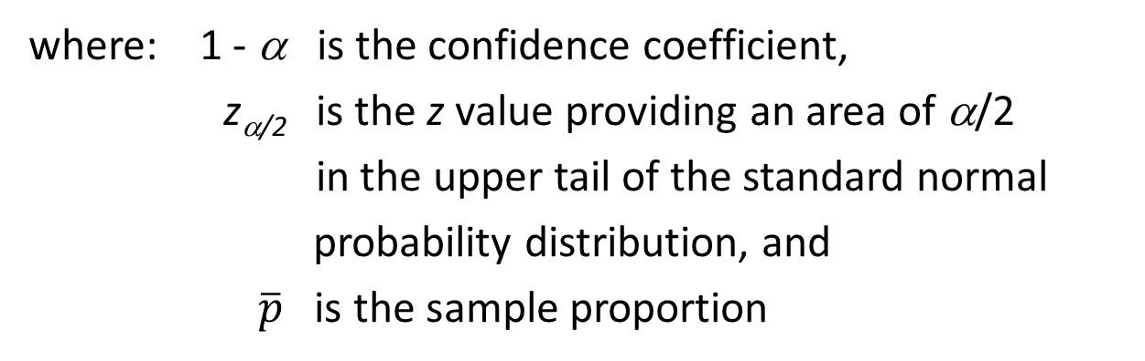
Interval Estimate of a Population Proportion
Interval Estimate
$$\overline{p}±z_{α/2}\sqrt{\frac{\overline{p}(1−\overline{p})}{n}}$$
where: 1 - α is the confidence coefficient,
z_{α/2} is the z value providing an area of α/2
in the upper tail of the standard normal
probability distribution, and
$\overline{p}$ is the sample proportion

Slide 40
Interval Estimate of a Population Proportion
Example: Political Science, Inc.
Political Science Inc. (PSI) specializes in voter polls and surveys designed to keep political office seekers informed of their position in a race.
Using telephone surveys, PSI interviewers ask registered voters who they would vote for if the election were held that day.
In a current election campaign, PSI has just found that 220 registered voters, out of 500 contacted, favor a particular candidate. PSI wants to develop a 95% confidence interval estimate for the proportion of the population of registered voters that favor the candidate.

Slide 41
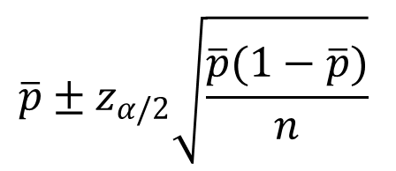
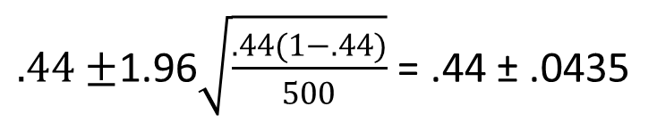
Interval Estimate of a Population Proportion
$$\overline{p}±z_{α/2}\sqrt{\frac{\overline{p}(1−\overline{p})}{n}}$$
where: n = 500, $\overline{p}$ = 220/500 = .44, z_{α/2} = 1.96
$.44±$1.96$\sqrt{\frac{.44(1−.44)}{500}}$ = .44 ± .0435
PSI is 95% confident that the proportion of all voters
that favor the candidate is between .3965 and .4835.

Slide 42
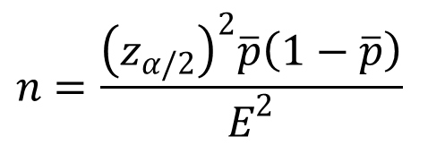
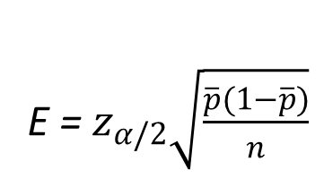
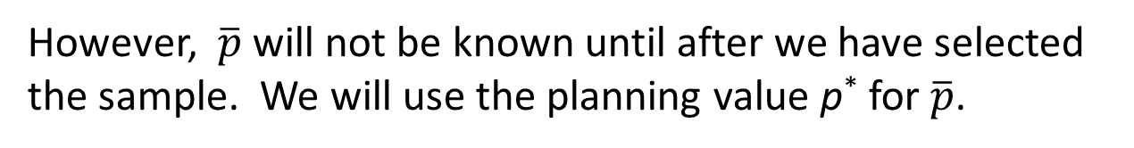
Sample Size for an Interval Estimate of a Population Proportion
Margin of error
E = $z_{α/2}\sqrt{\frac{\overline{p}(1−\overline{p})}{n}}$
Solving for the necessary sample size n, we get
$$n=\frac{{\left(z_{α/2}\right)}^{2}\overline{p}\left(1−\overline{p}\right)}{E^{2}}$$
However, $\overline{p}$ will not be known until after we have selected the sample. We will use the planning value p* for $\overline{p}$.

Slide 43
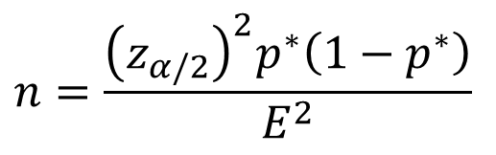
Sample Size for an Interval Estimate of a Population Proportion
Necessary Sample Size
$$n=\frac{{\left(z_{α/2}\right)}^{2}p^{∗}\left(1−p^{∗}\right)}{E^{2}}$$
The planning value p* can be chosen by:
1. Using the sample proportion from a previous sample of the same or similar units, or
2. Selecting a preliminary sample and using the
sample proportion from this sample.
3. Using judgment or a “best guess” for a p* value.
4. Otherwise, using .50 as the p* value.

Slide 44
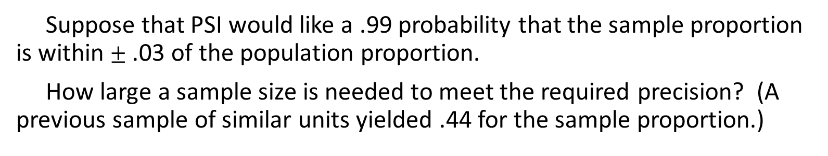
Sample Size for an Interval Estimate of a Population Proportion
Example: Political Science, Inc.
Suppose that PSI would like a .99 probability that the sample proportion is within $±$ .03 of the population proportion.
How large a sample size is needed to meet the required precision? (A previous sample of similar units yielded .44 for the sample proportion.)

Slide 45
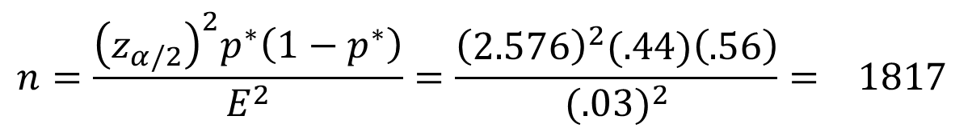
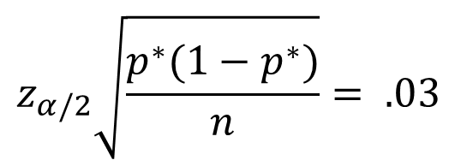
Sample Size for an Interval Estimate of
a Population Proportion
$$z_{α/2}\sqrt{\frac{p^{∗}(1−p^{∗})}{n}}= .03$$
At 99% confidence, z_{.005} = 2.576. Recall that p* = .44.
$$n=\frac{{\left(z_{α/2}\right)}^{2}p^{∗}\left(1−p^{∗}\right)}{E^{2}}=\frac{{\left(2.576\right)}^{2}(.44)\left(.56\right)}{{(.03)}^{2}}= 1817$$
A sample of size 1817 is needed to reach a desired precision of + .03 at 99% confidence.

Slide 46
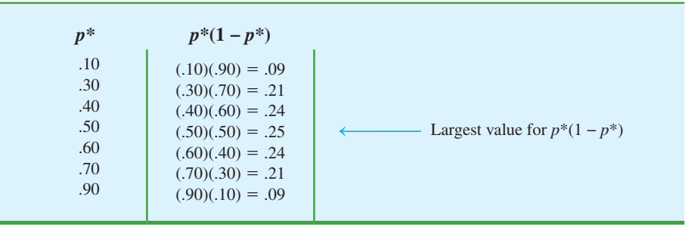
Sample Size for an Interval Estimate of
a Population Proportion
Note: We used .44 as the best estimate of p in the preceding expression. If no information is available about p, then .5 is often assumed because it provides the highest possible sample size. If we had used p = .5, the recommended n would have been 1843.

Slide 47
Recommendations
As the sample size becomes extremely large, the margin of error becomes extremely small and resulting confidence intervals become extremely narrow.
No interval estimate will accurately reflect the parameter being estimated unless the sample is relatively free of non-sampling error.
Statistical inference along with information collected from other sources can help in making the most informed decision.

Slide 48
Questions for Practice
Data were collected on the amount spent by 64 customers for lunch at a major Houston restaurant. These data are contained in the file named Houston. based upon past studies the population standard deviation is known with σ = $6.
a. At 99% confidence, what is the margin of error?
b. Develop a 99% confidence interval estimate of the mean amount spent for lunch

Slide 49
Questions for Practice
Older people often have a hard time finding work. AARP reported on the number of weeks it takes a worker aged 55 plus to find a job. The data on number of weeks spent searching for a job contained in the file JobSearch are consistent with the AARP findings.
a. Provide a point estimate of the population mean number of weeks it takes a worker aged 55 plus to find a job.
b. At 95% confidence, what is the margin of error?
c. What is the 95% confidence interval estimate of the mean?

Slide 50
Questions for Practice
According to statistics reported on CNBC, a surprising number of motor vehicles are not covered by insurance. Sample results, consistent with the CNBC report, showed 46 of 200 vehicles were not covered by insurance.
a. What is the point estimate of the proportion of vehicles not covered by insurance?
b. Develop a 95% confidence interval for the population proportion.

Slide 51
End of Chapter 8

